Slide 1
Java Basics

Slide 2
Naming convention
Naming conventions are used to make Java programs more readable.
It is important to use meaningful and unambiguous names.
Class Names
Class names should be nouns, as they represent “things” or “objects.”
They should be mixed case (camel case) with only the first letter of each word capitalized, as in the following:
public class InsurencePremium {...}

Slide 3
Interface Names
Interface names should be adjectives.
They should end with “able” or “ible” whenever the interface provides a capability; otherwise, they should be nouns.
Interface names follow the same capitalization convention as class names:
public interface Serializable {...}
public interface SystemPanel {...}

Slide 4
Method Names
Method names should contain a verb, as they are used to make
an object take action.
They should be mixed case, beginning with a lowercase letter, and the first letter of each subsequent word should be capitalized.
Adjectives and nouns may be included in method names:
public void locate() {...} // verb
public String getWayPoint() {...} // verb and noun

Slide 5
Instance and Static Variable Names
Instance and static variable names should be nouns and should
follow the same capitalization convention as method names:
private String wayPoint;

Slide 6
Parameter and Local Variable Names
Parameter and local variable names should be descriptive lowercase single words, acronyms, or abbreviations.
If multiple words are necessary, they should follow the same capitalization convention as method names:
public void printHotSpots(ArrayList spotList) {
int counter = 0;
for (String hotSpot : spotList) {
System.out.println("Hot Spot #“ + ++counter + ": " + hotSpot);
}
}
Temporary variable names may be single letters such as i, j, k, m, and n for integers and c, d, and e for characters.

Slide 7
Generic Type Parameter Names
Generic type parameter names should be uppercase single letters.
The letter T for type is typically recommended.
The Collections Framework makes extensive use of generics. E is used for collection elements, S is used for service loaders, and K and V are used for map keys and values:
public interface Map <K,V> {
V put(K key, V value);
}

Slide 8
Constant Names
Constant names should be all uppercase letters, and multiple words should be separated by underscores:
public static final int MAX_DEPTH = 200;

Slide 9
Enumeration Names
Enumeration names should follow the conventions of class names.
The enumeration set of objects (choices) should be all uppercase letters:
enum Battery {CRITICAL, LOW, CHARGED, FULL}

Slide 10
Package Names
Package names should be unique and consist of lowercase letters.
Underscores may be used if necessary:
package com.valueslabs.pams;
Publicly available packages should be the reversed Internet domain name of the organization, beginning with a single-word top-level domain name (e.g., com, net, org, or edu), followed by the name of the organization and the project or division.

Slide 11
Annotation Names
Annotation names have been presented several ways in the Java SE API for predefined annotation types, [adjective|verb][noun]:
@Documented
@Retention(RetentionPolicy.RUNTIME)
@Target(ElementType.TYPE)
public @interface FunctionalInterface {}

Slide 12
Acronyms
When using acronyms in names, only the first letter of the acronym
should be uppercase and only when uppercase is appropriate:
public String getGpsVersion() {...}

Slide 13
Lexical Elements
Java source code consists of words or symbols called lexical elements or tokens.
Java lexical elements include:
line terminators, whitespace,
comments, keywords, identifiers,
separators, operators, and literals.
The words or symbols in the Java programming language are comprised of the Unicode character set.

Slide 14
Unicode and ASCII
Maintained by the Unicode Consortium standards organization,
Unicode is the universal character set with the first 128 characters being the same as those in the American Standard Code for Information Interchange (ASCII) character set.
Unicode provides a unique number for character, usable across all platforms, programs, and languages.
Java 9 is supporting Unicode 8 version.
Java comments, identifiers, and string literals are not limited to ASCII characters.

Slide 15
Printable ASCII Characters
ASCII reserves code 32 (spaces) and codes 33 to 126 (letters, digits,
punctuation marks, and a few others) for printable characters.
Table contains the decimal values followed by the corresponding
ASCII characters for these codes.

Slide 16
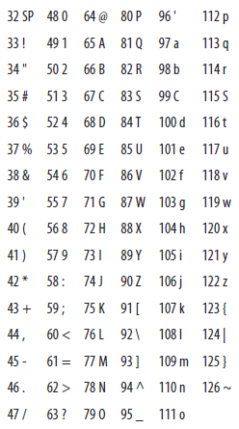

Slide 17
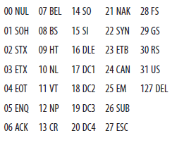
Nonprintable ASCII Characters
ASCII reserves decimal numbers 0–31 and 127 for control characters.

Slide 18
Comments
A single-line comment begins with two forward slashes and ends immediately before the line terminator character:
// A comment on a single line
A multiline comment begins with a forward slash immediately followed by an asterisk, and ends with an asterisk immediately followed by a forward slash. The single asterisks in between provide nice formatting convention; they are typically used, but are not required:
/*
* A comment that can span multiple lines
* just like this
*/

Slide 19
A Javadoc comment is processed by the Javadoc tool to generate API documentation in HTML format. A Javadoc comment must begin with a forward slash, immediately followed by two asterisks, and end with an asterisk immediately followed by a forward slash:
/** This is my Javadoc comment */
In Java, comments cannot be nested:
/* This is /* not permissible */ in Java */

Slide 20
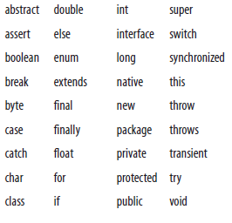
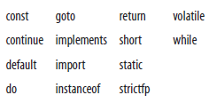
Keywords
Java keywords cannot be used as identifiers in a Java program.
Two of these, the const and goto keywords, are reserved but are not used by the Java language.

Slide 21
Identifiers
A Java identifier is the name that a programmer gives to a class, method, variable, and so on.
Identifiers cannot have the same Unicode character sequence as any keyword, boolean, or null literal.
Java identifiers are made up of Java letters. A Java letter is a character for which Character.isJavaIdentifierStart(int) returns true. Java letters from the ASCII character set are limited to the dollar sign ($), the underscore symbol (_), and upper- and lowercase letters.

Slide 22
Digits are also allowed in identifiers, but after the first character:
// Valid identifier examples
class TestDriver {...}
String testVariable;
int _testVariable;
Long $testVariable;
startTest(testVariable1);

Slide 23
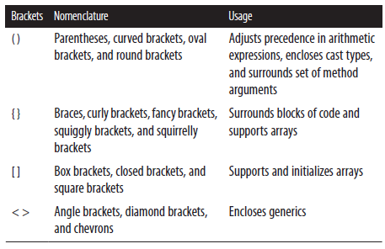
Separators
Several ASCII characters delimit program parts and are used as separators. (), { }, and [ ] are used in pairs:
() { } [ ] < > :: : ; , . ->

Slide 24
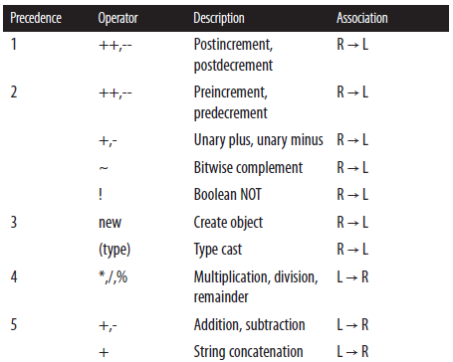
Operators

Slide 25
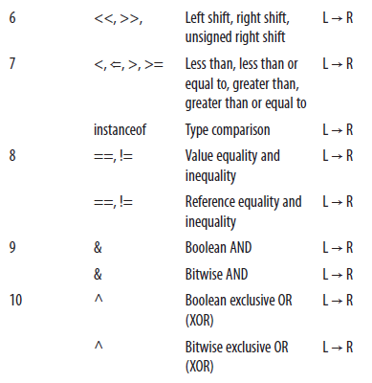
Continued…

Slide 26
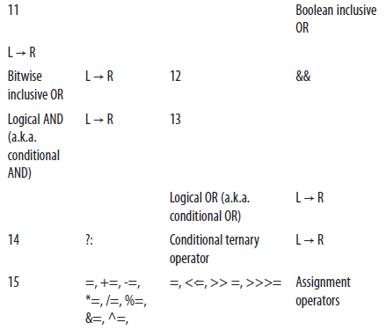
Continued…

Slide 27
Literals
Literals are source code representation of values. As of Java SE 7, underscores are allowed in numeric literals to enhance readability of the code. The underscores may only be placed between individual numbers and are ignored at runtime.

Slide 28
Boolean Literals
Boolean literals are expressed as either true or false:
boolean isReady = true;
boolean isSet = new Boolean(false); // unboxed
boolean isGoing = false;

Slide 29
Character Literals
A character literal is either a single character or an escape sequence contained within single quotes. Line terminators are not allowed:
char charValue1 = 'a';
// An apostrophe
Character charValue2 = new Character ('\'');

Slide 30
Integer Literals
Integer types (byte, short, int, and long) can be expressed in decimal, hexadecimal, octal, and binary. By default, integer literals are of type int:
int intValue1 = 34567, intValue2 = 1_000_000;
Decimal integers contain any number of ASCII digits, zero through nine, and represent positive numbers:
Integer integerValue1 = new Integer(100);
Prefixing the decimal with the unary negation operator can form a negative decimal:
public static final int INT_VALUE = -200;

Slide 31
Continued…
Hex numbers can represent positive and negative integers and zero:
int intValue3 = 0X64; // 100 decimal from hex
Octal literals begin with a zero followed by one or more ASCII digits zero through seven:
int intValue4 = 0144; // 100 decimal from octal
Binary literals are expressed using the prefix 0b or 0B followed by
zeros and ones:
char msgValue1 = 0b01001111; // O
char msgValue2 = 0B01001011; // K
char msgValue3 = 0B0010_0001; // !

Slide 32
Continued…
To define an integer as type long, suffix it with an ASCII letter L (preferred and more readable) or l:
long longValue = 100L;

Slide 33
Floating-Point Literals
A valid floating-point literal requires a whole number and/or a fractional part, decimal point, and type suffix. An exponent prefaced by an e or E is optional. Fractional parts and decimals are not required when exponents or type suffixes are applied.

Slide 34
Continued…
A floating-point literal (double) is a double-precision floating point of eight bytes. A float is four bytes. Type suffixes for doubles are d or D; suffixes for floats are f or F:
float floatValue1 = 9.15f, floatValue2 = 1_168f;
Float floatValue3 = new Float(20F);
double doubleValue1 = 3.12;
Double doubleValue2 = new Double(1e058);
float expValue1 = 10.0e2f, expValue2=10.0E3f;

Slide 35
String Literals
String literals contain zero or more characters, including escape sequences enclosed in a set of double quotes. String literals cannot contain Unicode \u000a and \u000d for line terminators; use \r and \n instead. Strings are immutable:
String stringValue1 = new String("Valid literal.");
String stringValue2 = "Valid.\nOn new line.";
String stringValue3 = "Joins str" + "ings";
String stringValue4 = "\"Escape Sequences\"\r";

Slide 36
Continued…
There is a pool of strings associated with class String. Initially, the pool is empty. Literal strings and string-valued constant expressions are interned in the pool and added to the pool only once.
The following example shows how literals are added to and used in the pool:
// Adds String "thisString" to the pool
String stringValue5 = "thisString";
// Uses String "thisString" from the pool
String stringValue6 = "thisString";

Slide 37
Continued…
A string can be added to the pool (if it does not already exist in the pool) by calling the intern() method on the string. The intern() method returns a string, which is either a reference to the new string that was added to the pool or a reference to the existing string:
String stringValue7 = new String("thatString");
String stringValue8 = stringValue7.intern();

Slide 38
Null Literals
The null literal is of type null and can be applied to reference types. It does not apply to primitive types:
String n = null;

Slide 39
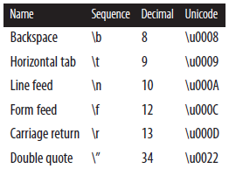
Escape Sequences

Slide 40
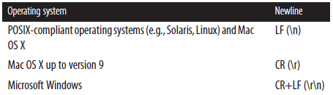
Different line terminators
System.lineSeparator()

Slide 41
Binary Numeric Promotion
When two primitives of different numerical types are compared via the operators, one type is promoted based on the following binary promotion rules:
If either operand is of type double, the non-double primitive is converted to type double.
If either operand is of type float, the non-float primitive is converted to type float.
If either operand is of type long, the non-long primitive is converted to type long.
Otherwise, both operands are converted to int.

Slide 42
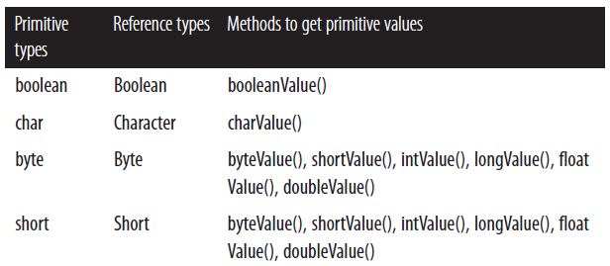
Wrapper Classes
Each of the primitive types has a corresponding wrapper class/ reference type, which is located in package java.lang.

Slide 43
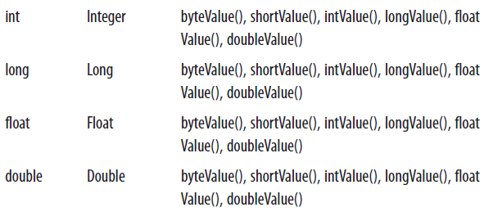
Continued…

Slide 44
Autoboxing and Unboxing
Autoboxing and unboxing are typically used for collections of primitives.
Autoboxing involves the dynamic allocation of memory and initialization of an object for each primitive.
Unboxing involves the production of a primitive for each object.
Note that the overhead can often exceed the execution time of the desired operation.
Computationally intensive tasks using primitives should be done using arrays of primitives in preference to collections of wrapper objects.

Slide 45
Autoboxing
Autoboxing is the automatic conversion of primitive types to their corresponding wrapper classes.
// Create hash map of weight groups
HashMap<String, Integer> weightGroups = new HashMap<String, Integer> ();
weightGroups.put("welterweight", 147);
weightGroups.put("middleweight", 160);
weightGroups.put("cruiserweight", 200);
The following example shows an acceptable but not recommended use of autoboxing:
// Establish weight allowance
Integer weightAllowanceW = 5; //improper
Integer weightAllowanceW = new Integer (5);

Slide 46
Unboxing
Unboxing is the automatic conversion of the wrapper classes to their corresponding primitive types.
// Get the stored weight limit
int weightLimitP = weightGroups.get(middleweight);
// Establish the weight allowance
weightLimitP = weightLimitP + weightAllowanceW;
weightLimitP = weightLimitP + weightAllowanceW.intValue();

Slide 47
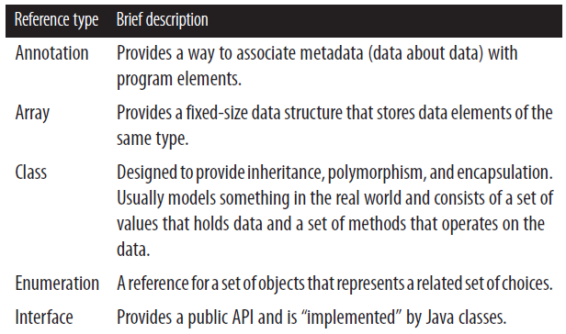
Reference Types

Slide 48
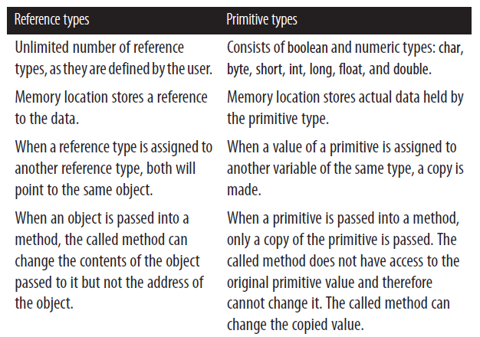
Comparing Reference Types to Primitive Types

Slide 49
Conversion of Reference Types
An object can be converted to the type of its superclass (widening) or any of its subclasses (narrowing).
Widening Conversions
Widening implicitly converts a subclass to a parent class(superclass).
Widening conversions do not throw runtime exceptions.
No explicit cast is necessary:
String s = new String();
Object o = s; // widening

Slide 50
Narrowing Conversions
Narrowing converts a more general type into a more specific type.
Narrowing is a conversion of a superclass to a subclass.
An explicit cast is required. To cast an object to another object, place the type of object to which you are casting in parentheses immediately before the object you are casting.
Illegitimate narrowing results in a ClassCastException.
Narrowing may result in a loss of data/precision.
Object c = new Object();
String d = (Integer) c; // compile-time error
Objects cannot be converted to an unrelated type—that is, a type other than one of its subclasses or superclasses.

Slide 51
Passing Reference Types into Methods
When an object is passed into a method as a variable:
A copy of the reference variable is passed, not the actual object.
The caller and the called methods have identical copies of the reference.
The caller will also see any changes the called method makes to the object. Passing a copy of the object to the called method will prevent it from making changes to the original object.
The called method cannot change the address of the object, but it can change the contents of the object.

Slide 52
Continued…
void roomSetup() {
// Reference passing
Table table = new Table();
table.setLength(72);
// Length will be changed
modTableLength(table);
// Primitive passing
// Value of chairs not changed
int chairs = 8;
modChairCount(chairs);
}
void modTableLength(Table t) {
t.setLength(36);
}
void modChairCount(int i) {
i = 10;
}

Slide 53
Comparing Reference Types
Equality operators and the equals method can be used to assist with comparisons.
Guest guest1 = new Guest("name");
Guest guest2 = guest1;
if (guest1 == guest2)
System.out.println("They are equal")
Guest guest3 = new Guest("name");
Guest guest4 = new Guest("name");
if (guest3 == guest4)
System.out.println("They are equal.")
else
System.out.println("They are not equal")

Slide 54
Using the equals() Method
To compare the contents of two class objects, the equals()method from class Object can be used or overridden.
When the equals() method is overridden, the hashCode()method should also be overridden. This is done for compatibility with hashbased collections such as HashMap() and HashSet().
if you want to compare values contained in two instances of the same class, you should use a programmer defined equals() method.

Slide 55
Comparing Strings
There are two ways to check whether strings are equal in Java, but the definition of “equal” for each of them is different. Typically, if the goal is to compare character sequences contained in two strings, the equals() method should be used:
The equals() method compares two strings, character by character, to determine equality. This is not the default implementation of the equals() method provided by the Object class. This is the overridden implementation provided by String class.
The == operator checks to see whether two object references refer to the same instance of an object.
Objects of the String class are immutable. Objects of the StringBuffer and StringBuilder classes are mutable.

Slide 56
Continued…
class MyComparisons {
String first = "chairs"; // Add string to pool
String second = "chairs"; // Use string from pool
String third = new String ("chairs"); // Create a new string
void myMethod() {
if (first == second) { // Contrary to popular belief, this evaluates to true. Try it!
System.out.println("first == second");
}
if (first.equals(second)) { // This evaluates to true
System.out.println("first equals second");
}
if (first == third) { // This evaluates to false
System.out.println("first == third");
}
if (first.equals(third)) { // This evaluates to true
System.out.println("first equals third");
}
} // End myMethod()
} //end class

Slide 57
Comparing Enumerations
enum values can be compared using == or the equals()method because they return the same result. The == operator is used more frequently to compare enumeration types.

Slide 58
Copying Reference Types
When reference types are copied, either a copy of the reference to an object is made; or an actual copy of the object is made, creating a new object. The latter is referred to as cloning in Java.

Slide 59
Copying a Reference to an Object
When copying a reference to an object, the result is one object with two references. In the following example, closingSong is assigned a reference to the object pointed to by lastSong. Any changes made to lastSong will be reflected in closingSong and vice versa:
Song lastSong = new Song();
Song closingSong = lastSong;

Slide 60
Cloning Objects
Cloning results in another copy of the object, not just a copy of a reference to an object. Cloning is not available to classes by default. Note that cloning is usually very complex, so you should consider a copy constructor instead:
For a class to be cloneable, it must implement the interface Cloneable.
The protected method clone() allows for objects to clone themselves.
For an object to clone an object other than itself, the clone() method must be overridden and made public by the object being cloned.
When cloning, a cast must be used because clone() returns type object.
Cloning can throw a CloneNotSupportedException.

Slide 61
Shallow and deep cloning
Shallow and deep cloning are the two types of cloning in Java.
In shallow cloning, primitive values and the references in the object being cloned are copied.
Copies of the objects referred to by those references are not made.
In deep cloning, the cloned object makes a copy of each of its object’s fields, recursing through all other objects referenced by it.
A deep-clone method must be defined by the programmer, as the Java API does not provide one.
Alternatives to deep cloning are serialization and copy constructors. (Copy constructors are often preferred over serialization.)

Slide 62
Continued…
Class Song {
String title;
Artist artist;
float length;
int year;
void setData() {...}
public static void main(String args[]) {
Song firstSong = new Song();
try {
// Make an actual copy by cloning
Song leadingSong = (Song)firstSong.clone();
} catch (CloneNotSupportedException cnse) {
cnse.printStackTrace();
}
}
} // end

Slide 63
Classes and Objects
Classes define entities that usually represent something in the real world. They consist of a set of values that holds data and a set of methods that operates on the data.
An instance of a class is called an object, and it is allocated memory. There can be multiple instances of a class.
Classes can inherit data members and methods from other classes. A class can directly inherit from only one class—the superclass.
A class can have only one direct superclass. This is called inheritance.
When implementing a class, the inner details of the class should be private and accessible only through public interfaces. This is called encapsulation.

Slide 64
Class Syntax
A class has a class signature, optional constructors, data members, and methods:
[javaModifiers] class className [extends someSuperClass]
[implements someInterfaces separated by commas] {
// Data member(s)
// Constructor(s)
// Method(s)
}

Slide 65
Instantiating a Class (Creating an Object)
An object is an instance of a class. Once instantiated, objects have their own set of data members and methods:
// Sample class definitions
public class Candidate {...}
class Stats extends ToolSet {...}
public class Report extends ToolSet implements Runnable {...}
Separate objects of class Candidate are created (instantiated) using the keyword new:
Candidate candidate1 = new Candidate();
Candidate candidate2 = new Candidate();

Slide 66
Data Members and Methods
Data members, also known as fields, hold data about a class. Data members that are non-static are also called instance variables:
[javaModifier] type dataMemberName
Methods operate on class data:
[javaModifiers] type methodName (parameterList)
[throws listOfExceptionsSeparatedByCommas] {
// Method body
}

Slide 67
Continued…
public class Candidate {
// Data members or fields
private String firstName;
private String lastName;
private int year;
// Methods
public void setYear (int y) { year = y; }
public String getLastName() {return lastName;}
} // End class Candidate

Slide 68
Accessing Data Members and Methods in Objects
The dot operator (.) is used to access data members and methods in objects. It is not necessary to use the dot operator when accessing data members or methods from within an object:
candidate1.setYear(2016);
String name = getFirstName() + getLastName();

Slide 69
Overloading
Methods, including constructors, can be overloaded. Overloading means that two or more methods have the same name but different signatures (parameters and return values).
Note that overloaded methods must have different parameters, and they may have different return types; but having only different return types is not overloading. The access modifiers of overloaded methods can be different:
public class VotingMachine {
...
public void startUp() {...}
private void startUp(int delay) {...}
}

Slide 70
Continued…
When a method is overloaded, it is permissible for each of its signatures to throw different checked exceptions:
private String startUp(District d) throws new
IOException {...}

Slide 71
Overriding
A subclass can override the methods it inherits. When overridden, a method contains the same signature (name and parameters) as a method in its superclass, but it has different implementation details.
The method startUp() in superclass Display is overridden in class TouchScreenDisplay:
public class Display {
void startUp(){
System.out.println("Using base display.");
}
}
public class TouchScreenDisplay extends Display {
void startUp() {
System.out.println("Using new display.");
}
}

Slide 72
Continued…
Rules regarding overriding methods include the following:
Methods that are not final, private, or static can be overridden.
Protected methods can override methods that do not have access modifiers.
The overriding method cannot have a more restrictive access modifier (i.e., package, public, private, protected) than the original method.
The overriding method cannot throw any new checked exceptions.

Slide 73
Constructors
Constructors are called upon object creation and are used to initialize data in the newly created object. Constructors are optional, have exactly the same name as the class, and they do not have a return in the body (as methods do).
A class can have multiple constructors. The constructor that is called when a new object is created is the one that has a matching signature:
public class Candidate {
Candidate(int id) {
this.identification = id;
}
Candidate(int id, int age) {
this.identification = id;
this.age = age;
}
}
// Create a new Candidate and call its constructor
Candidate candidate = new Candidate(id);
Classes implicitly have a no-argument constructor if no explicit constructor is present. Note that if a constructor with arguments is added, there will be no no-argument constructor unless it is manually added.

Slide 74
The this Keyword
The three common uses of the this keyword are to refer to the current object, to call a constructor from within another constructor in the same class, and to pass a reference of the current object to another object. To assign a parameter variable to an instance variable of the current object:
public class Curtain extends PrivacyWall {
String color;
public void setColor(String color) {
this.color = color;
}
}
To call a constructor from another constructor in the same class:
public class Curtain extends PrivacyWall {
public Curtain(int length, int width) {}
public Curtain() {this(10, 9);}
}

Slide 75
Continued…
To pass a reference of the current object to another object:
// Print the contents of class curtain
System.out.println(this);

Slide 76
Variable-Length Argument Lists
Methods can have a variable-length argument list. Called varargs, these methods are declared such that the last (and only the last) argument can be repeated zero or more times when the method is called.
The vararg parameter can be either a primitive or an object.
type... objectOrPrimitiveName
public setDisplayButtons(int row, String... names) {...}
// at compile time the above varags can be modified to below
public setDisplayButtons(int row, String [] names) {...}

Slide 77
Continued…
// Zero or more
public void setDisplayButtons (String... names) {...}
setDisplayButtons(“Karan");
setDisplayButtons(“Raghu", “Siva", “Sanjay");
setDisplayButtons(“Krishna", “Meghana", “Venkat", “Kiran");
public PrintStream printf(String format, Object... args)
System.out.printf("Hello voter %s%nThis is machine %d%n", “Ram", 1);

Slide 78
Abstract Classes and Abstract Methods
An abstract class is typically used as a base class and cannot be instantiated.
It can contain abstract and non-abstract methods, and it can be a subclass of an abstract or a non-abstract class.
All of its abstract methods must be defined by the classes that inherit
(extend) it unless the subclass is also abstract.
public abstract class Alarm {
public void reset() {...}
public abstract void renderAlarm();
}

Slide 79
Continued…
An abstract method contains only the method declaration, which must be defined by any non-abstract class that inherits it:
public class DisplayAlarm extends Alarm {
public void renderAlarm() {
System.out.println("Active alarm.");
}
}

Slide 80
Static Data Members, Static Methods, Static Constants, and Static Initializers
Static data members have the same features as static methods and are stored in a single location in memory. They are used when only one copy of a data member is needed across all instances of a class (e.g., a counter):
// Declaring a static data member
public class Voter {
static int voterCount = 0;
public Voter() { voterCount++;}
public static int getVoterCount() {
return voterCount;
}
}
...
int numVoters = Voter.voterCount;

Slide 81
Continued…
Static methods have the keyword static in the method declaration:
// Declaring a static method
class Analyzer {
public static int getVotesByAge() {...}
}
// Using the static method
Analyzer.getVotesByAge();
Static methods cannot access non-static methods or variables because static methods are associated with a class, not an object.

Slide 82
Continued…
Static constants are static members declared constant. They have the keywords static and final, and a program cannot change them:
// Declaring a static constant
static final int AGE_LIMIT = 18;
// Using a static constant
if (age == AGE_LIMIT)
newVoter = "yes";

Slide 83
Continued…
Static initializers include a block of code prefaced by the keyword static.
A class can have any number of static initializer blocks, and it is guaranteed that they will run in the order in which they appear.
Static initializer blocks are executed only once per class initialization.
// Static Initializer
static {
numberOfCandidates = getNumberOfCandidates();
}

Slide 84
Interfaces
Interfaces provide a set of declared public methods that do not have method bodies.
A class that implements an interface must provide concrete implementations of all the methods defined by the interface, or it must be declared abstract.
An interface is declared using the keyword interface, followed by the name of the interface and a set of method declarations.
interface Reportable {
void genReport(String repType);
void printReport(String repType);
}

Slide 85
Continued…
A class that implements an interface must indicate so in its class signature with the keyword implements:
class VotingMachine implements Reportable {
public void genReport (String repType) {
Report report = new Report(repType);
}
public void printReport(String repType) {
System.out.println(repType);
}
}
Classes can implement multiple interfaces, and interfaces can extend multiple interfaces.

Slide 86
Enumerations
In simplest terms, enumerations are a set of objects that represent a related set of choices:
enum DisplayButton {ROUND, SQUARE}
DisplayButton round = DisplayButton.ROUND;
Looking beyond simplest terms, an enumeration is a class of type enum and it is a singleton. Enum classes can have methods, constructors, and data members:
enum DisplayButton {
// Size in inches
ROUND (.50f),
SQUARE (.40f);
private final float size;
DisplayButton(float size) {this.size = size;}
private float size() { return size; }
}

Slide 87
Continued…
The method values() returns an array of the ordered list of objects defined for the enum:
for (DisplayButton b : DisplayButton.values())
System.out.println("Button: " + b.size());

Slide 88
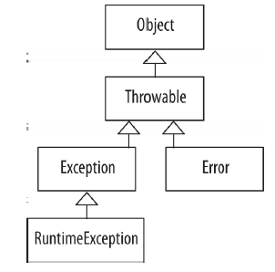
Exception Handling
An exception is an anomalous (deviating from standard) condition that alters or interrupts the flow of execution. Java provides built-in exception handling to deal with such conditions.
All exceptions and errors inherit from the class Throwable, which inherits from the class Object

Slide 89
Checked/Unchecked Exceptions and Errors
Checked Exceptions
Checked exceptions are checked by the compiler at compile time.
Methods that throw a checked exception must indicate so in the method declaration using the throws clause. This must continue all the way up the calling stack until the exception is handled.
All checked exceptions must be explicitly caught with a catch block.
Checked exceptions include exceptions of the type Exception, and all classes that are subtypes of Exception, except for RuntimeException and the subtypes of RuntimeException.
// Method declaration that throws an IOException
void readFile(String filename) throws IOException {
...
}

Slide 90
Unchecked Exceptions
The compiler does not check unchecked exceptions at compile time.
Unchecked exceptions occur during runtime due to programmer error (out-of-bounds index, divide by zero, and null pointer exception) or system resource exhaustion.
Unchecked exceptions do not have to be caught.
Methods that may throw an unchecked exception do not have to (but can) indicate this in the method declaration.
Unchecked exceptions include exceptions of the type RuntimeException and all subtypes of RuntimeException.

Slide 91
Errors
Errors are typically unrecoverable and present serious conditions.
Errors are not checked at compile time and do not have to be (but can be) caught/handled.
Any checked exceptions, unchecked exceptions, or errors can be caught.

Slide 92
Common Checked/Unchecked Exceptions and Errors
Common Checked Exceptions
ClassNotFoundException
Thrown when a class cannot be loaded because its definition cannot be found.
IOException
Thrown when a failed or interrupted operation occurs. Two common subtypes of IOException are EOFException and FileNotFoundException.
FileNotFoundException
Thrown when an attempt is made to open a file that cannot be found.
SQLException
Thrown when there is a database error.

Slide 93
Continued…
InterruptedException
Thrown when a thread is interrupted.
NoSuchMethodException
Thrown when a called method cannot be found.
CloneNotSupportedException
Thrown when clone() is called by an object that is not cloneable.

Slide 94
Common Unchecked Exceptions
ArithmeticException
Thrown to indicate that an exceptional arithmetic condition has occurred.
ArrayIndexOutOfBoundsException
Thrown to indicate index out of range.
ClassCastException
Thrown to indicate an attempt to cast an object to a subclass of which it is not an instance.
DateTimeException
Thrown to indicate problems with creating, querying, and manipulating date-time objects.

Slide 95
Continued…
IllegalArgumentException
Thrown to indicate that an invalid argument has been passed to a method.
IllegalStateException
Thrown to indicate that a method has been called at an inappropriate time.
IndexOutOfBoundsException
Thrown to indicate that an index is out of range.
NullPointerException
Thrown when code references a null object but a non-null object is required.
NumberFormatException
Thrown to indicate an invalid attempt to convert a string to a numeric type.

Slide 96
Common Errors
AssertionError
Thrown to indicate that an assertion failed.
ExceptionInInitializeError
Thrown to indicate an unexpected exception in a static initializer.
VirtualMachineError
Thrown to indicate a problem with the JVM.
OutOfMemoryError
Thrown when there is no more memory available to allocate an object or perform garbage collection.

Slide 97
Continued…
NoClassDefFoundError
Thrown when the JVM cannot find a class definition that was found at compile time.
StackOverflowError
Thrown to indicate that a stack overflow occurs.

Slide 98
Exception Handling Keywords
Error-handling code is cleanly separated from error generating code.
Code that generates the exception is said to “throw” an exception, whereas code that handles the exception is said to “catch” the exception
Example to continue…

Slide 99
// Declare an exception
public void methodA() throws IOException {
...
throw new IOException();
...
}
// Catch an exception
public void methodB() {
/* Call to methodA must be in a try/catch block since the exception is a checked exception; otherwise methodB could throw the exception */
try {
methodA();
}catch (IOException ioe) {
System.err.println(ioe.getMessage());
ioe.printStackTrace();
}
}

Slide 100
The throw Keyword
To throw an exception, use the keyword throw. Any checked/ unchecked exception and error can be thrown:
if (n == -1)
throw new EOFException();

Slide 101
The try/catch/finally Keywords
Thrown exceptions are handled by try, catch, finally block. The Java interpreter looks for code to handle the exception, first looking in the enclosed block of code, and then propagating up the call stack to main() if necessary. If the exception is not handled on the main thread (i.e., not the Event Dispatch Thread [EDT]), the program exits and a stack trace is printed:
try {
method();
} catch (EOFException eofe) {
eofe.printStackTrace();
} catch (IOException ioe) {
ioe.printStackTrace();
} finally {
// cleanup
}

Slide 102
The try-catch Statement
The try block contains code that may throw exceptions.
All checked exceptions that may be thrown must have a catch block to handle the exception.
If no exceptions are thrown, the try block terminates normally.
A try block may have zero or more catch clauses to handle the exceptions.
A try block must have at least one catch or finally block associated with it.
There cannot be any code between the try block and any of the catch blocks or the finally block.

Slide 103
Continued…
The catch block(s) contain code to handle thrown exceptions, including printing information about the exception to a file, giving users an opportunity to input correct information.
Note that catch blocks should never be empty because such “silencing” results in exceptions being hidden, which makes errors harder to debug.
A common convention for naming the parameter in the catch clause is a set of letters representing each of the words in the name of the exception.
catch (ArrayIndexOutOfBoundsException aioobe) {
aioobe.printStackStrace();
}
Within a catch clause, a new exception may also be thrown if necessary.
The order of the catch clauses in a try/catch block defines the precedence for catching exceptions. Always begin with the most specific exception that may be thrown and end with the most general.

Slide 104
The try-finally Statement
The try-finally statement includes one try and one finally block.
The finally block is used for releasing resources when necessary:
public void testMethod() throws IOException {
FileWriter fileWriter = new FileWriter("\\data.txt");
try {
fileWriter.write("Information...");
} finally {
fileWriter.close();
}
}
This block is optional and is only used where needed. When used, it is executed last in a try-finally block and will always be executed, whether or not the try block terminates normally. If the finally block throws an exception, it must be handled.

Slide 105
The try-catch-finally Statement
The try-catch-finally statement includes one try, one or more catch blocks, and one finally block. For this statement, the finally block is also used for cleanup and releasing resources:
public void testMethod() {
FileWriter fileWriter = null;
try {
fileWriter = new FileWriter("\\data.txt");
fileWriter.write("Information...");
} catch (IOException ex) {
ex.printStackTrace();
} finally {
try {
fileWriter.close();
} catch (Exception e) {
e.printStackTrace();
}
}
}

Slide 106
The try-with-resources Statement
The try-with-resources statement is used for declaring resources that must be closed when they are no longer needed. These resources are declared in the try block:
public void testMethod() throws IOException {
try (FileWriter fw = new FileWriter("\\data.txt")) {
fw.write("Information...");
}
}
Any resource that implements the AutoClosable interface may be used with the try-with-resources statement.

Slide 107
The multi-catch Clause
The multi-catch clause is used to allow for multiple exception arguments in one catch clause:
boolean isTest = false;
public void testMethod() {
try {
if (isTest) {
throw new IOException();
} else {
throw new SQLException();
}
} catch (IOException | SQLException e) {
e.printStackTrace();
}
}

Slide 108
The Exception Handling Process
Here are the steps to the exception handling process:
An exception is encountered, which results in an exception object being created.
A new exception object is thrown.
The runtime system looks for code to handle the exception, beginning with the method in which the exception object was created. If no handler is found, the runtime environment raverses the call stack (the ordered list of methods) in reverse looking for an exception handler. If the exception is not handled, the program exits and a stack trace is automatically output.
The runtime system hands the exception object off to an exception handler to handle (catch) the exception.

Slide 109
Defining Your Own Exception Class
Programmer-defined exceptions should be created when those other than the existing Java exceptions are necessary. In general, the Java exceptions should be reused wherever possible:
To define a checked exception, the new exception class must extend the Exception class, directly or indirectly.
To define an unchecked exception, the new exception class must extend the RuntimeException class, directly or indirectly.
To define an unchecked error, the new error class must extend the Error class.

Slide 110
Continued…
User-defined exceptions should have at least two constructors— a constructor that does not accept any arguments and a constructor that does:
public class ReportException extends Exception {
public ReportException () {}
public ReportException (String message, int reportId) {
...
}
}

Slide 111
Printing Information About Exceptions
The methods in the Throwable class that provide information about thrown exceptions are getMessage(), toString, and printStackTrace(). In general, one of these methods should be called in the catch clause handling the exception. Programmers can also write code to obtain additional useful information when an exception occurs (i.e., the name of the file that was not found).
The getMessage() Method
The getMessage() method returns a detailed message string about the exception:
try {
new FileReader("file.js");
} catch (FileNotFoundException fnfe) {
System.err.println(fnfe.getMessage());
}

Slide 112
Continued…
The toString() Method
This toString() method returns a detailed message string about the exception, including its class name:
try {
new FileReader("file.js");
} catch (FileNotFoundException fnfe) {
System.err.println(fnfe.toString());
}

Slide 113
Continued…
The printStackTrace() Method
This printStackTrace() method returns a detailed message string about the exception, including its class name and a stack trace from where the error was caught, all the way back to where it was thrown:
try {
new FileReader("file.js");
} catch (FileNotFoundException fnfe) {
fnfe.printStackTrace();
}

